Slide 1
CS 4530: Fundamentals of Software Engineering Module 09 Writing Maintainable Code: Code-Level Design Principles
Adeel Bhutta
Khoury College of Computer Sciences
© 2026 Released under the CC BY-SA license

Slide 2
Learning Objectives for this Lesson
By the end of this lesson you should be able to:
Describe the purpose of our best practices for code-level design
List 6 principles for writing readable code, with examples
Identify some violations of the practices and suggest ways to mitigate them
Notes:
<Read Slide>

Slide 3
Software systems must be comprehensible by humans
Which humans?
The other members of your team
The folks who will maintain and modify your system
Management
Your clients
and ...
You, a week from now or 6 weeks from now
Notes:
To put this in context, Design is the SE activity before coding. There is a saying in SE that goes like this: “Design is not coding, coding is not design”. Design is a critical part of your SE process.
<Read slide>

Slide 4
Non-Functional Qualities of Code
Readability – ease of reading code/understanding it
Maintainability – ease of fixing defects
Extensibility – ease of adding new components without changing existing ones
Configurability – ease of changing behavior by end-users
Testability – ease of writing tests
Scalability – ease of improving performance with more computing resources
Notes:
Potential brainstorming in class: Did you ever work with a system that scored so poorly on any of these qualities that it was re-written from scratch? Most likely case might be systems that were just not extendible

Slide 5
Use Design to Control Complexity
Software systems must be comprehensible by humans
Why? Software needs to be maintainable
continuously adapted to a changing environment
Maintenance takes 50–80% of the cost
Why? Software needs to be reusable
Economics: cheaper to reuse than rewrite!
Consider design costs as an investment in reducing future costs
5
Notes:
<Read Slide>
A relevant question here often is, what are qualities of a good design? Mitch Kapor (Lotus123) says that “good design must exhibit firmness, commodity and delight.

Slide 6
Three Scales of Design in Software Engineering
PEOPLE
PROCESSES
PROGRAMS
PLANNING
ORGANIZING
implementing
Notes:
This is a picture we’ve looked at many times this semester — software engineering deals with people, process, and programs, and it takes place at multiple levels of design. We’ve previously called these “planning”, “organizing” and “implementing”, but these words aren’t perfect for this.
In focusing on the design of programs — of code — some other words might fit better.

Slide 7
A Different Perspective On The Three Scales of Design
PROGRAMS
The Structural Scale
key questions: what are the pieces? how do they fit together to form a coherent whole?
The Interaction Scale
key questions: how do the pieces interact? how are they related?
The Code Scale
key question: how can I make the actual code easy to test, understand, and modify?
PLANNING
ORGANIZING
implementing
Notes:
Things like the Controller-Service-Repository design live at the upper levels of program design — understanding the high-level structure of software is sometimes called software architecture.
Remember that Design is often an iterative process. Design may happen at all these scales at once.

Slide 8
Today’s topic: design principles at the code scale
The Structural Scale
key questions: what are the pieces? how do they fit together to form a coherent whole?
The Interaction Scale
key questions: how do the pieces interact? how are they related?
The Code Scale
key question: how can I make the actual code easy to test, understand, and modify?
Notes:
Today we’re talking about the implementation of programs at the scale of code — individual functions and their construction.
Brainstorm: why should we think about the design of code in a software engineering class? (We want code to be readable? We want to avoid bugs? We want to )
Brainstorm: which of the quality attributes might be most connected to the code scale? (Readability?)
Brainstorm: what are the tasks for which readability is important? (code review, debugging, feature development…)

Slide 9
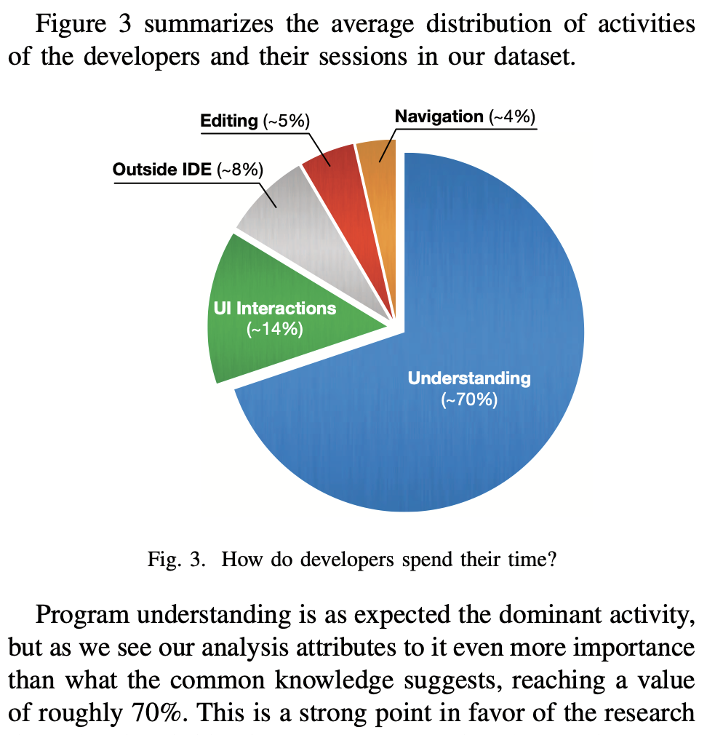
Developers spend more time understanding code than writing it
Study methodology:
Instrument 18 developer’s IDEs for 740 development sessions
Record time spent in different tasks
Conclusion: 70% of time spent in understanding-related tasks
Other studies have shown similar statistics
“I know what you did last summer: an investigation of how developers spend their time” Minelli, Mocci and Lanza. ICPC 2015
Notes:
What’s our purpose in thinking about design principles at the code scale?
There’s relatively robust evidence that people spend more time understanding code than writing it, and it’s unlikely that current trends in how code is created are going to change that equation.
So if we’re humans writing code, we’re writing code for humans to read. (Unless we think of ourselves as writing code for robots to read, but the current trend seems to be the other way around — robots are writing code for humans to read, or robots or writing code for humans to read…)
So: the purpose of thinking about design at the code scale is that we should be making our code understandable by humans.

Slide 10
An Insultingly Shallow Introduction to Cognitive Psychology
Writing code engages memory
Short term memory holds “7±2 chunks”
A chunk might be anything that has meaning
What counts as a chunk is relative to concepts you already have
The number of chunks in STM is fixed, but chunks might be different size.
Example:
6, 1, 7, 3, 7, 3, 2, 4, 6, 2 --10 chunks
617-373-2462 -- 3 chunks
Sensory memory
attention
Short-term memory
rehearsal
transfer
Long-term memory
https://en.wikipedia.org/wiki/Atkinson%E2 %80%93Shiffrin_memory_model
Notes:
We needed to understand a very tiny bit of networking and distributed systems to explain the structural- and interaction-scale design principles around the controller-service-architecture.
We’re going to introduce a very tiny bit of cognitive psychology in order to talk about principles for writing understandable code.
(click to reveal Atkinson-Shiffrin model)
Disclaimers:
- you've probably seen something like this before in your psych class
- there are entire graduate degrees you could get on this stuff
- most of this is from, like, the 1960s
There are lots of systematic models that try to approximate how our brains work in a useful way, and they all have different uses and value. The Atkinson-Shiffrin model is an ”oldie but a goodie” — most models involve some kind of sensory memory (a high resolution copy of everything we’re seeing and hearing), long-term memory (which we usually model as being slow but having essentially unlimited capacity), and a short term memory that mediates between them.
Not much can fit in to short term memory
(click to reveal short term memory)
Wikipedia calls George Miller’s 1956 paper The Magical Number Seven, Plus or Minus Two ”one of the most highly cited papers in psychology.” The theory is that our short term memory is limited to an astounding degree — we can only “juggle” about seven chunks of information, plus or minus two.
What's a chunk? A 'chunk' is a single unit of stuff that has meaning. "having meaning" is of course relative what concepts you already have.
Yes, that's kind of slippery, but it's good enough for our purposes — this isn’t a cognitive psychology class!
The important thing is that meaning can change — this was one of the reasons “Miller’s law” was introduced. It’s challenging to remember a sequence of ten digits: that’s too many!
(click)
But somehow, we manage to keep phone numbers in our short term memory. The structure of a phone number creates bigger chunks!

Slide 11
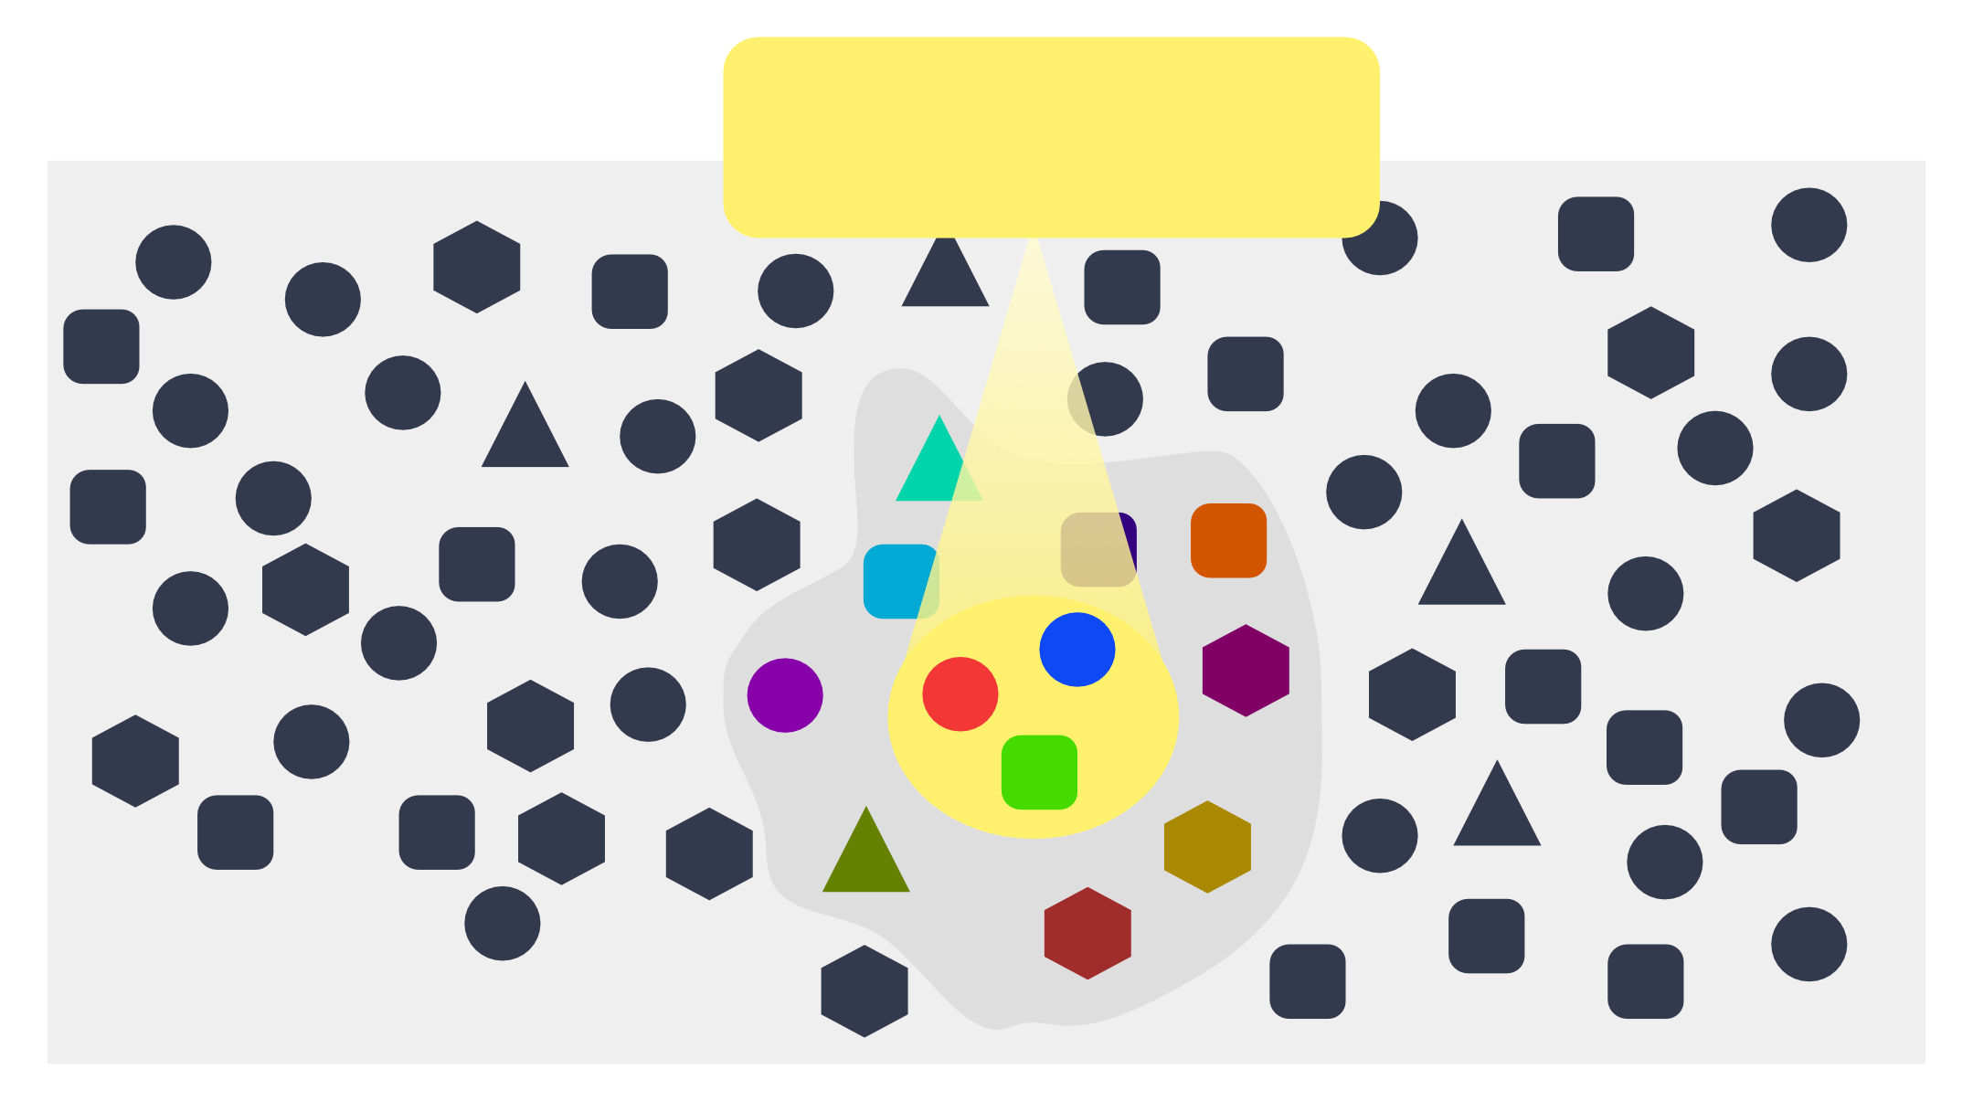
Minimize Your Reader's Cognitive Load
Understanding code requires a developer to:
Access their long-term memory (e.g. for language syntax, API documentation)
Long term memory: unlimited capacity, much slower
Access their short-term memory (e.g. for tracking keywords, variable names, etc)
Short-term memory capacity: 7 ± 2 items ("chunks")
Manipulate new thoughts, ideas, etc in working memory
working
memory
long-term memory
https://en.wikipedia.org/wiki/Working_memory
Notes:
Understanding code requires using our cognitive processes.
As we discuss those design principles, we’ll try to connect them back to these ideas of long-term and short-term memory in order to help you understand *why* we chose these principles. Some of the design principles we discuss are empirically validated — there’s an entire field of empirical studies of programming — and some are good guesses based on our models of human cognition.

Slide 12
Cognitive Load Example
Long Term Memory
const t : number
Short-Term Memory
t number
Knowledge on names, types
Working Memory
t number
Knowledge of names
https://theelearningcoach.com/learning/what-is-cognitive-load/
Notes:
When you see the variable “const t: number” and try to understand what this means, the general cognition process is:
You place the variable name (and perhaps its type) in your short term memory.
This information is drawn into your working memory, and you search your long-term memory for information that might explain what the variable does.
If you HAVE seen this code before recently, and have a good memory (e.g. you saw it on the last slide), you’ll be able to retrieve the information that “t” refers to “temperature” in this context. But, if you came back to it after a looking at more code, it’s more likely that you’d need pull multiple facts from your LTM, with less certainty of which refers to this “t”. Especially if there is somewhere else in your code where “t” means temporary ☺. -- Greater cognitive load

Slide 13
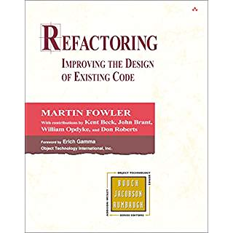
The Book
A catalogue of refactorings, similar to the design patterns in the GoF book
Names each transformation
Helpful for team communication
Names “bad smells” (triggers for refactorings)
Discusses when and how to apply refactorings and provides insight into tradeoffs
Notes:
If you are interested, you can find a lot more in the book:
UML diagrams to illustrate the situation before and after
examples of code before and after each refactoring

Slide 14
Five general-purpose design principles for understandability and maintainability
Five General Principles
1. Use Names and Indentation Wisely
2. Make Your Data Mean Something
3. One Method/One Job
4. Don't Repeat Yourself
5. Identify and Use Good Abstractions
Notes:
Here are five general-purpose principles that apply to just about all programming tasks, which generally can’t be automatically checked by linters. We’ve phrased this in terms of programming practices: things that you can do to make your code better.
I suggest that you make a sticky note with this list and keep it on your laptop screen or somewhere in your workspace so that you will be constantly reminded of it.

Slide 15
Principle 1. Use names and indentation wisely (consistently)
Names and indentation are the first thing a reader sees in your code.
Let's look at each of them
Notes:
<Read Slide>

Slide 16
Use Good Names
The name of a thing is a first clue to the reader about what the thing means.
often, it's the only clue ☹
Use good names for
constants
variables
functions/methods
data types
Good names support chunking
Notes:
<Read Slide>

Slide 17

Use Good Names for Variables and Types
const t : number
const l : number
const temp : number
const loc : number
const temperature : Temperature
const sensorLocation : SensorLocation
const temperature : number
const sensorLocation : number
Notes:
What do these variables mean?
Better names would give the reader a clue
<click>
This is a little better. But does 'temp' mean 'temporary', or 'temperature', or something else?
<click>
Better names for the data types would be even better.
<click>
We’ll say more about this in a minute, when we get to Principle 2: Make Your Data Mean Something

Slide 18
Use Good Names for Functions and Methods
function checkLine (line) : boolean
function lineIsTooLong (line) : boolean
Notes:
Here is another example of a bad name, but now of a method.
What are you checking it for? Length? Illegal Syntax? or what?
<click>
Ahh, now we know!

Slide 19
Use Good Names for Functions and Methods
Use noun-like names for functions or methods that return values, e.g.
not:
Reserve verb-like names for functions or methods that perform actions, like
const c = new Circle(initRadius)
const a = c.diameter()
const a = c.calculateDiameter()
table1.addItem(student1,grade1)
Notes:
In the real world, your workplace should have coding standards for things like this
In this course, these conventions are part of our official coding standards.

Slide 20
Use Standard Patterns with Standard Names
eg addListener, removeListener for Observer pattern
.instance() for singleton pattern
use similar names for similar operations
don't call it getSomething in one place and fetchSomething in another place.
functions with similar names should behave similarly
if getSomething throws an error on failure then getAnotherThing should also throw an error on failure.
Notes:
When you work on your team project, you may want to impose coding conventions you will use. For example, you might decide that functions named `getSomething` do a certain kind of thing, and functions named `filterSomething` do some other kind of thing.

Slide 21
Good Names Draw on Broad Long-Term Memory Knowledge
Long Term Memory
const temp : Temperature
Short-Term Memory
temp Temperature
Working Memory
temp Temperature
Weather Knowledge
Naming Conventions
Long Term Memory
Weather
Constants
i, j, k
Domain Knowledge
Programming Concepts
Conventions
Sensors
Types
t, temp
Notes:
One of the most useful ways to improve understandability of names is to draw on the broad long-term memory. For example, when you see the variable “temp: Temperature,” you will draw not only on knowledge of naming conventions, but also domain knowledge – like about the weather.

Slide 22
Standardizing Names is More Important than the Standard Itself
Using a naming convention consistently in a codebase improves understanding
Consider standardizing:
snake_case vs camelCase vs PascalCase
Abbreviations in names vs words written out fully
Maximum name length
For this course, we have some naming policies in our style guidelines
We've covered some of these on the preceding slides.
Notes:
When you work on your team project, you may want to impose coding conventions you will use. For example, you might decide that functions named `getSomething` do a certain kind of thing, and functions named `filterSomething` do some other kind of thing.

Slide 23
Use Consistent Indentation to Transmit Structure
function foo
(x: number, y: number,
shouldIncrement: boolean)
: number {
if (shouldIncrement)
x++;
x *= 2;
x += y;
return x;
}
function foo
(x: number, y: number,
shouldIncrement: boolean)
: number {
if (shouldIncrement) {
x++;
}
x *= 2; // correct indentation
x += y;
return x;
}
Auto-indentation is your friend!
Override it at your peril!
Notes:
Sometimes very simple things can improve the readability of your code. <click>
Here we've inserted a pair of braces, so you can immediately see the scope of `shouldIncrement`. And we've properly indented the x*=2, which was misleadingly indented in the original.
Things like this can be done easily with eslint and auto-indentation in Visual Studio.

Slide 24
Eslint is your friend!
Use eslint rules to enforce the coding styles in your shop.
Many common eslint rules help you avoid errors.
Others ensure that important information is present in a place where the reader will need it.

Slide 25
Principle 2. Make Your Data Mean Something
You need to do three things:
Decide what part of the information in the "real world" needs to be represented as data
Decide how that information needs to be represented as data
Document how to interpret the data in your computer as information about the real world
Notes:
“Make Your Data Mean Something” What does that mean? It means that when you design your data, you need to do three things: <read bullets>

Slide 26
Example: Temperature Sensor
We want to track the temperature of sensors in different locations
How should we represent our sensor and its location?
We need to decide:
How to represent sensors (including their temperature)
How to represent temperature and locations
How to represent a specific sensor, like one in the bathroom

Slide 27
One Way of Representing a Temperature Sensor
type Sensor = {
location: SensorLocation
currentTemperature?: Temperature
}
type Temperature = {
degreesFahrenheit: number
}
type SensorLocation = "Basement" | "Bathroom" | "Kitchen";
let bathroomTemperatureSensor: Sensor = {
location: "Bathroom"
}
Notes:
Here we've put everything into Typescript objects, with labelled fields.
QUESTION: What are the advantages and disadvantages of this representation? DISCUSS
(POSSIBLE ISSUES:
space
time (to create and extract fields)
extensibility (add new locations)
flexibility (the ? on current temperature allows the creation of a sensor before it has a temperature).

Slide 28

The Big Picture
representation
let bathroomTemperatureSensor: Sensor = {
location: "Bathroom"
}
interpretation
How do we know that these are connected?
Answer: we have to write it down.
In Typescript, we do that with names, types and comments (or documentation)
Notes:
Here’s the big picture. On the left, we have a fact about the real world: there is a temperature sensor on the ceiling in the bathroom.
On the right, we see how that real-world fact is represented in our code.
We *represent* a real-world fact in code
We *interpret* the code as a real-world fact.
How do we know these are connected? We have to *write it down*.
Otherwise the next person who looks at this code won’t know what we meant.
In our Typescript system, we do that with names, types, and comments.

Slide 29
Another Example: what does (x,y) mean?
representation
export interface BoundingBox {
x: number;
y: number;
width: number;
height: number;
};
???
interpretation
The center?
Upper-left-hand corner?
Does y grow in the up or down direction?
And what about the units? (Pixels? Scaled pixels? Something else?)
Answer: we should have written this down!
Notes:
Here's another example, taken from an Individual Project a few semesters ago.
Here's what we put in the starter code.
And here are some of the questions about this that were asked on Piazza at that time.

Slide 30
Principle 3: One Method/One Job
Each class, and each method of that class, should have one job, and only one job
If your method has more than one job, split it into 2 methods. Why?
You might want one part but not the other
It's easier to test a method that has only one job
You call both of them if you need to.
or write a single method that calls them both
Same thing for classes.
Notes:
<Read slide>
The fancy name for this is "The Single Responsibility Principle". You can use this if you want to impress your coop interviewer.

Slide 31
One Method/One Job Allows for Better In-Memory Chunking
Recall: we have limited capacity in our short-term memory
We get to remember “chunks”
Splitting long methods into smaller ones with good names helps us hold more code in our short-term memory

Slide 32
Principle 4: Don't Repeat Yourself
If you have some quantity that you use more than once, give it a name and use the name.
That way you only need to change it in one place!
And of course you should use a good name
If you have some task that you do in many places, make it into a procedure.
If the tasks are slightly different, turn the differences into parameters.
Notes:
If you have some quantity that you use more than once, give it a name and use the name.
That way you only need to change it in one place!
If you have some task that you do in many places, make it into a procedure.
This is called "Single Point of Control"
And of course you should use a good name

Slide 33
A real example
function testequal <T> (testname: string, actualVal: T, correctVal: T) {
test(testname, () => { expect(actualVal).toBe(correctVal) })
}
describe('tests for countOfLocalMorks', function () {
testequal('empty crew',countOfLocalMorks(ship1),0)
testequal('just Mork',countOfLocalMorks(ship2),1)
testequal('just Mindy',countOfLocalMorks(ship3),0)
testequal('two Morks',countOfLocalMorks(ship4),2)
testequal('drone has no Morks',countOfLocalMorks(drone1),0)
})
This is what test.each does in Jest
Notes:
Here’s an actual example, from a couple of semesters ago, in Jest..
Think of how much typing this saves!
Plus, if I ever need to change what testequal does, I can do it all in one place.
Note: Jest has a built-in abstraction for this, called test.each , but that’s not the point of this example.
Discuss: how could this example be improved?

Slide 34
A better example
function testLocalMorks(testName: string, ship: Ship, expected: number) {
test(testName, () => {
expect(countOfLocalMorks(ship)).toBe(expected)
})
}
const testData = [
{ testname: 'emptyCrew', ship: ship1, expected: 0 },
{ testname: 'justMork', ship: ship2, expected: 1 },
{ testname: 'justMindy', ship: ship3, expected: 0 },
{ testname: 'twoMorks', ship: ship4, expected: 2 },
{ testname: 'droneNoMorks', ship: drone1, expected: 0 }
]
describe('tests for countOfLocalMorks', () => {
testData.forEach(({ testname, ship, expected }) => {
testLocalMorks(testname, ship, expected)
})
})
Notes:
Here's one way of improving it.
Now, if I want to add more test data, I can just add an entry to testData

Slide 35
Beware of clones
Terminology: “Code Clone” – a copy (or near-miss copy) of code within a codebase
Clones are created when DRY is violated
int foo(int j){
if(j<0)
return j;
else
return j++;
}
int goo(int j){
if(j<0)
return j;
else
return j--;
}
int getOrOffset(int j, boolean increment){
if(j<0)
return j;
else {
if(increment)
return j++;
else
return j--;
}
}
Notes:
<show the code on left, ask students to look at it. Then click to build the animation and say “See, here is a clone of the same function, just with a different name, right?”>
We can see that code clones are *especially* bad when they are near-misses. You look at these two code fragments, and the easiest thing for your brain to do is to assume that they are the same. But, they are not.
<click> Refactoring these two functions into one forces us to encode something about *what we mean* to do in these functions – in the name of the new function, and in its parameter names.

Slide 36
Principle 5: Identify and Use Good Abstractions
What's an "abstraction"?
It's usually something that's hidden in the problem statement
It's something that is used widely in your program
It's something where
the details or representation might change
you use it in ways that don't depend on the representation
Let’s look at a couple of examples.
Notes:
<read slide>

Slide 37
An abstraction is something that may be used in many places.
Replace magic numbers with good names
const salesPrice = netPrice * 1.06
const salesTaxRate = 1.06
const salesPrice = netPrice * salesTaxRate
Notes:
Where did that 1.06 come from?
Oh, it's the sales tax? Are there many occurrences of that 1.06 in your code? (Probably!) Will the sales tax rate ever change? (Probably!)
const's fix it!<click>

Slide 38
Example
Imagine we are computing income tax in a state where there are four rates:
One on incomes less than $10,000
One on incomes between $10,000 and $20,000
One on incomes between $20,000 and $50,000
One on incomes greater than $50,000
Notes:
Here’s another example:
<read slide>

Slide 39
You might write something like
function grossTax(income: number): number {
if ((0 <= income) && (income <= 10000)) { return 0 }
else if ((10000 < income) && (income <= 20000))
{ return 0.10 * (income - 10000) }
else if ((20000 < income) && (income <= 50000))
{ return 1000 + 0.20 * (income - 20000) }
else { return 7000 + 0.25 * (income - 50000) }
}
Lots of these details here might change
The boundaries of the tax brackets might change
The number of brackets might change
Notes:
Here’s a possible piece of code.
Here we’ve hard-coded the information about the tax brackets.
But those might certainly change. What might change?
The boundaries of the tax brackets might change
The number of brackets might change.
This tells us that the notion of a “tax bracket” is an important concept.
But this concept is not explicit in the code we’re looking at– it’s hard-wired into the code.
So probably we should have a representation of “a tax bracket” as a piece of data.
And once we realize that “tax bracket” is an important concept, we can also see that this piece of code violates One Function/One Job:
It finds the appropriate bracket AND calculates the appropriate tax.

Slide 40
"Tax Bracket" might be a good abstraction
We see there are four of them, but there might be more.
They are likely to be used in many places
A tax bracket has a lower bound, an (optional) upper bound, and a rate.
Each of these may change, but they always represent the same thing

Slide 41
So we can represent a tax bracket like this:
// represents a tax bracket for income lower < income <= upper.
// if upper is undefined, then lower < income (no upper bound)
type TaxBracket = {
lower: number,
upper: number | undefined,
base : number
rate : number
}
// defines the incomes covered by a bracket
function isInBracket(income:number, bracket:Bracket) : boolean {
if (bracket.upper == null)
{ return (bracket.lower < income) }
return ((bracket.lower < income) && (income <= bracket.upper)) }
function taxByBracket(income: number, bracket: Bracket): number {
return bracket.base + bracket.rate * (income - bracket.lower)
}
Notes:
So here’s a possible representation of a tax bracket. Note the comment on the first two lines, which tells us what a value of type TaxBracket means in the real world.
Among other things, we now have a single point of control if we ever need to change the brackets.
{Maybe discuss: note that the interpretation comment defines a half-open interval. Was this a good choice? Why or why not? There are two half-open intervals we could have used: (lower,upper] or [lower,upper) . What do you think of the choice specified here? (Clue: what would the tax be on income=0?
Would this design bug have been detected by a good test suite?)

Slide 42
And we'll also need to represent a tax table
// represents a tax table as an array of brackets.
// INVARIANT: ???
type TaxTable = Bracket[]
/** INVARIANT:
* 1. the brackets are a non-overlapping partition of the positive real numbers
* 2. the tax associated with the upper bound of a bracket is
* the same as the tax associated with the lower bound
* of the next higher bracket.
*/
/** NOTE:
* because the brackets are a non-overlapping partition of the positive real numbers,
* the brackets need not be sorted by lower bound.
*/
Notes:
A tax table can be represented by a list of brackets.
But will any old list of brackets be a sensible representation of a tax table?
DISCUSS
<click to show invariant>
{Discuss: how could this invariant be improved in light of the bug we highlighted on the preceding slide?}

Slide 43
And now it's easy to rewrite our function
// because the brackets are a non-overlapping partition of the positive real numbers,
// there will be a unique bracket for each income, so the "as Bracket" cast is safe. */
function income2bracket(income: number, table: TaxTable): Bracket {
return table.find(b0 => isInBracket(income, b0)) as Bracket
}
function grossTax2 (income:number, Table: TaxTable ) : number {
return taxByBracket(income,income2bracket(income,brackets))
}
Notes:
So here’s our rewritten code. And we are back to one function/one job.
Professor Wand says: “True story: My first draft of this code was quite different and had several bugs. I eventually located the bugs by rewriting the code with one function/one job. When I did that, it was easy to see which part was broken.”

Slide 44
Review: Learning Objectives for this Lesson
You should now be able to:
Describe the purpose of our best practices for code-level design
List 5 principles for designing readable code, with examples
Identify some violations of the practices and suggest ways to mitigate them

